Slide 1


SRI RAMAKRISHNA ENGINEERING COLLEGE
[Educational Service : SNR Sons Charitable Trust]
[Autonomous Institution, Reaccredited by NAAC with ‘A+’ Grade]
[Approved by AICTE and Permanently Affiliated to Anna University, Chennai]
[ISO 9001:2015 Certified and all Eligible Programmes Accredited by NBA]
VATTAMALAIPALAYAM, N.G.G.O. COLONY POST, COIMBATORE – 641 022.
ARTIFICIAL INTELLIGENCE AND DATA SCIENCE
20AD272- MINI-PROJECT -I
TITLE: SMART MONITORING APPLICATIONS FOR FARMERS
PROJECT MENTOR:
MR.C.RANJEETH KUMAR,AP(Sr.Gr)
DEPARTMENT OF INFORMATION TECHNOLOGY
TEAM MEMBERS:
2011005 ASFAN BASHA I
2011022 KAVIPRIYA B
2011029 MONISHAA S

Slide 2
AGENDA
ABSTRACT
OBJECTIVE
INTRODUCTION
LITERATURE SURVEY
REQUIRED TOOLS
FLOW CHART
MODULES
WORKING PRINCIPAL
RESULT
CONCLUSION
FUTURE SCOPE
REFERENCES

Slide 3
ABSTRACT
As Indian economy is highly dependent on the productivity of the agriculture. Failure of farmers to decide on the best suitable crop for the land using traditional methods is an interesting thing to note, also pest attacks reduces quality and productivity of the crop plants.
Manual detection of pests in leaf takes long time and efforts on the larger farm. The proposed system uses deep learning approach to accurately detect the pests on leaves.
Crop suggestion model is built by considering all the factors like sowing season, soil, and geographical location using Machine learning algorithm.
The proposed model also predict weather using Rest API Calls

Slide 4
OBJECTIVE
To develop a App called “Smart Monitoring App”.
To provide necessary details such as PH of the soil, nitrogen, phosphorus and various other elements as inputs for suitable crop outcomes.
To detect the pest affecting the leaves by using Convoluted Neural Network Algorithm.
To alert the farmers about the weather condition in prior
The main objective is to maximize the productivity and finding pest attack prior by the farmers.

Slide 5
INTRODUCTION
As the technology develop in the field of agricultural technology our country still lacks compared to others due to various reasons but still we are the most productive country.
This application is an simple approach that would help the farmers to overcome their minor problems that they face today and this reduce a minor possibility of not happening it.
This application gets the plant’s image from the user and using convolution neural network it process the image and detects the disease

Slide 6
INTRODUCTION
This would help the farmers who find it sometime difficult to identify the disease.
Weather conditions changes every day and prediction of weather is needful to the farmer since they could plan their upcoming days based on the weather
As well as the application also helps the farmers to detect the type of crop that would be beneficial to grow.
As a result we have tried our best to produce a simple application that would provide the mentioned functions.

Slide 7
LITERATURE REVIEW
Title | Author | Year of Publication | Description
Plant Disease Detection Using Image Processing | Sachin.D.Khirade , A.B.Patil | 2015 International Conference on Computing Communication Control and Automation | Author discussed about the various technique to segment the disease part of the part and also some feature extraction and classification techniques to extract the features of infected leaf and classification of diseases.

Slide 8
LITERATURE REVIEW
Title | Author | Year of Publication | Description
Leaf Disease Detection using Deep Learning | Teenu Sahasra M; Sai Kumari S; Sai Meghana S; P. Rama Devi | 2015 | This paper discussed the methods used for the detection of plant diseases using their leaves images. This paper also discussed some segmentation and feature extraction algorithm used in the plant disease detection.

Slide 9
LITERATURE REVIEW
Title | Author | Year of Publication | Description
Crop Recommender System Using Machine Learning Approach | SHILPA MANGESH PANDE; PREM KUMAR RAMESH; ANMOL ANMOL; B. R AISHWARYA; | 2021 | The user provides the area & soil type as input. Machine learning algorithms allow choosing the most profitable crop list or predicting the crop yield for a user-selected crop. To predict the crop yield, selected Machine Learning algorithms such as Support Vector Machine (SVM), Artificial Neural Network (ANN), Random Forest (RF), Multivariate Linear Regression (MLR), and K-Nearest Neighbour (KNN) are used

Slide 10
LITERATURE REVIEW
Title | Author | Year of Publication | Description
Krishi Ville - Android based solution for Indian agriculture | Manav Singhal; Kshitij Verma; Anupam Shukla | 2011 | This paper describes a mobile based application for farmers which would help them in their farming activities. We propose an android based mobile application - Krishi Ville which would take care of the updates of the different agricultural commodities, weather forecast updates, agricultural news updates.

Slide 11
REQUIRED TOOLS
IDE : Visual Studio , Flutter Framework
Language used : Python, Dart
Database : Plant disease dataset, Crop recommendation dataset

Slide 12
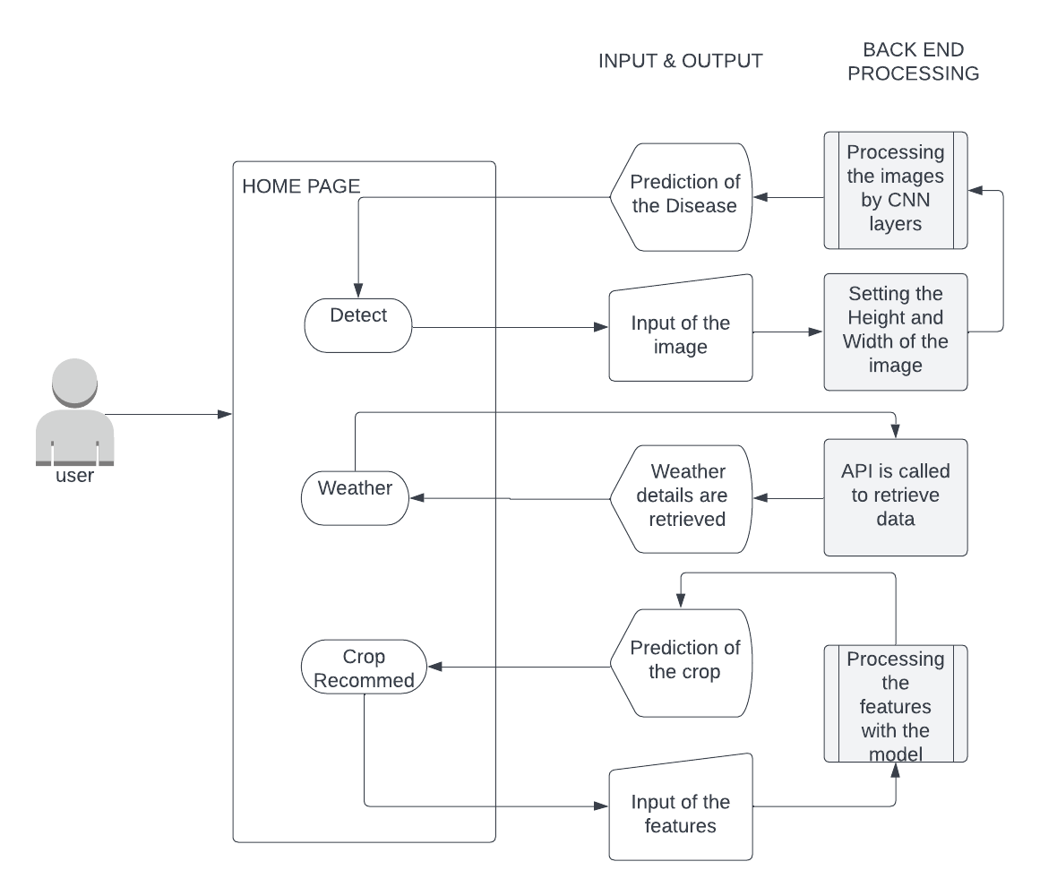
FLOW CHART

Slide 13
MODULE
MODULE 1 : Leaf Disease Detection
MODULE 2 : Weather Prediction Module
MODULE 3 : Crop Recommendation

Slide 14
LEAF DISEASE DETECTION
The pest detection module is implemented with the pest detection model we created using the Machine learning algorithms.
The model is converted into a Tflite model hence it could be integrated with the application’s user interface
We could upload the picture of the lead either from the gallery or take a picture using the camera
The Disease would be detected after uploading or taking the image of the leaf
The User Interface would display the
1.Disease Detected
2.Confidence

Slide 15
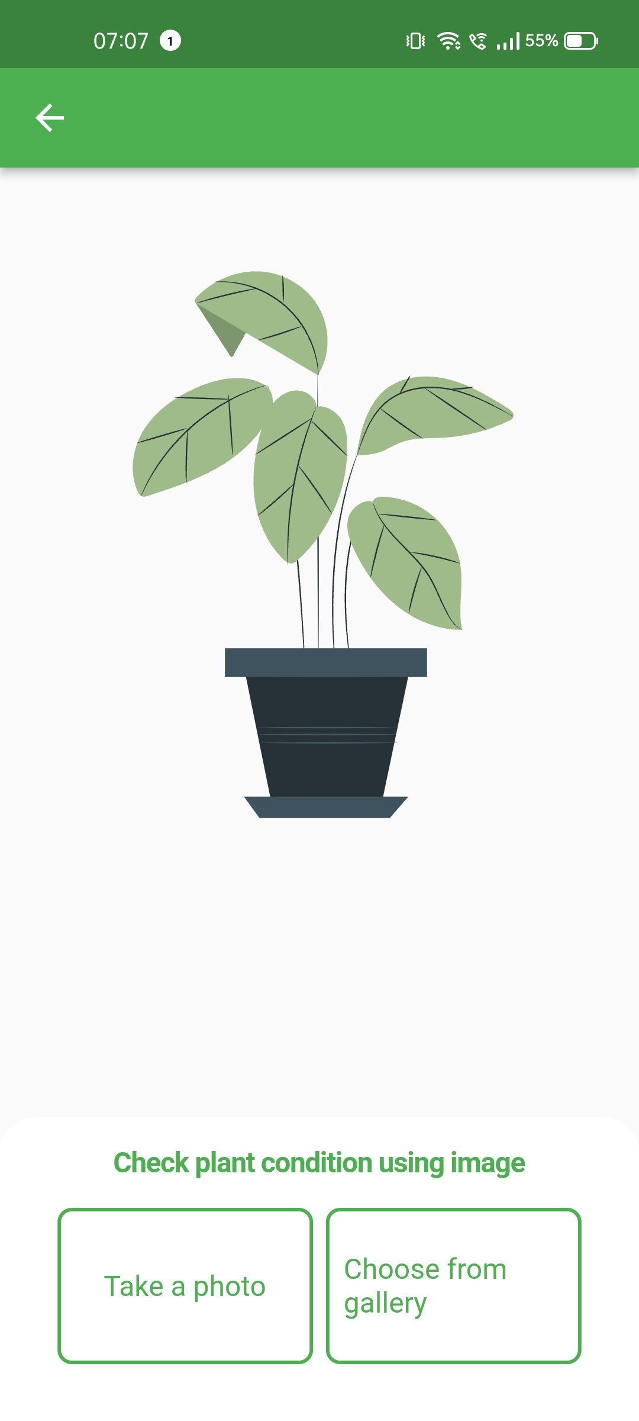
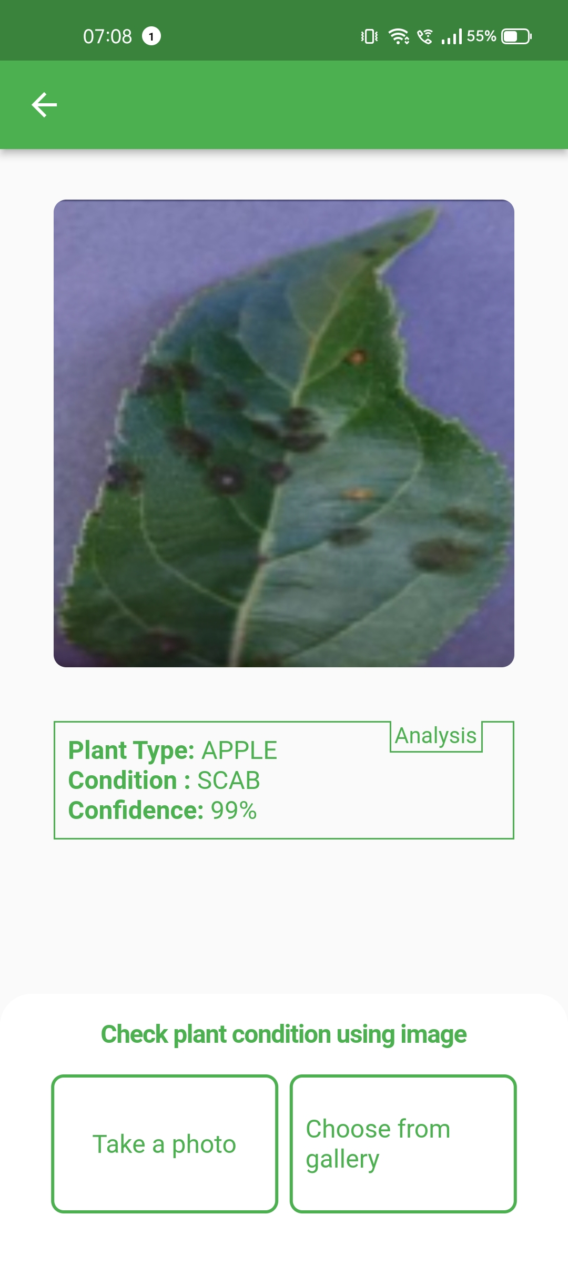
RESULT OF LEAF DISEASE DETECTION

Slide 16
WEATHER PREDICTION
The application uses the REST API’ from openweathermap.org to retrieve the weather forecast details.
An ‘app_id’ is created and it must be passed down with each API request to retrieve the current forecast of the user’s current location.
The application would request for the location access from the user and get the location details like latitude and longitude.
The user interface would display the
1. Current Weather of the location
2. Present day’s Hourly weather cast
3. 7 days forecast

Slide 17
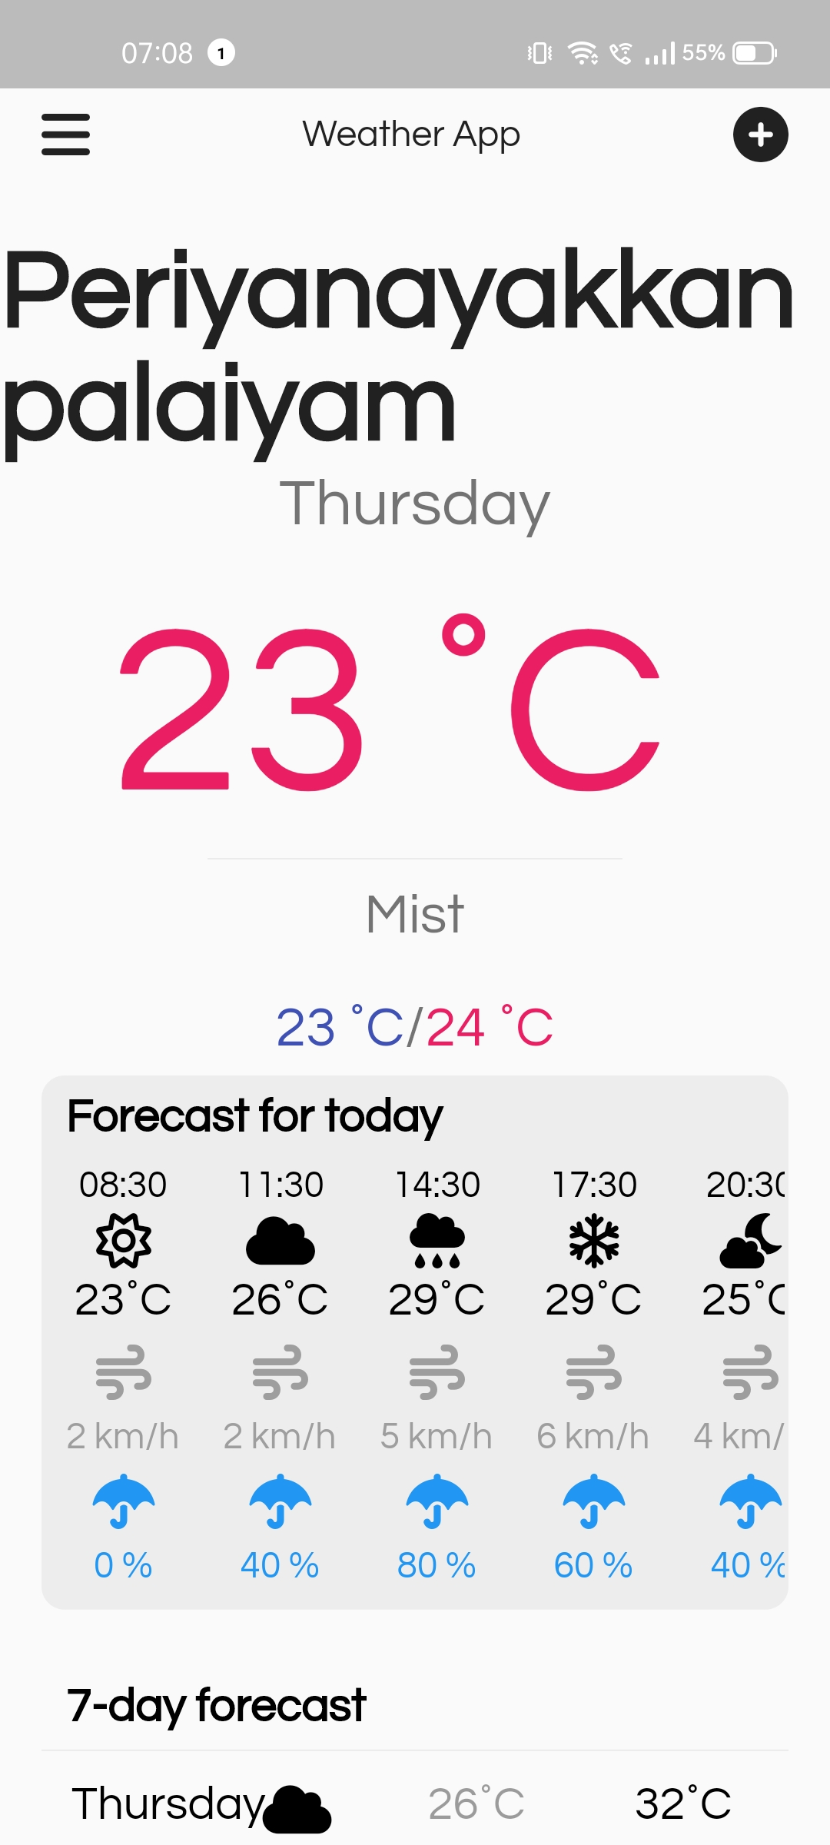
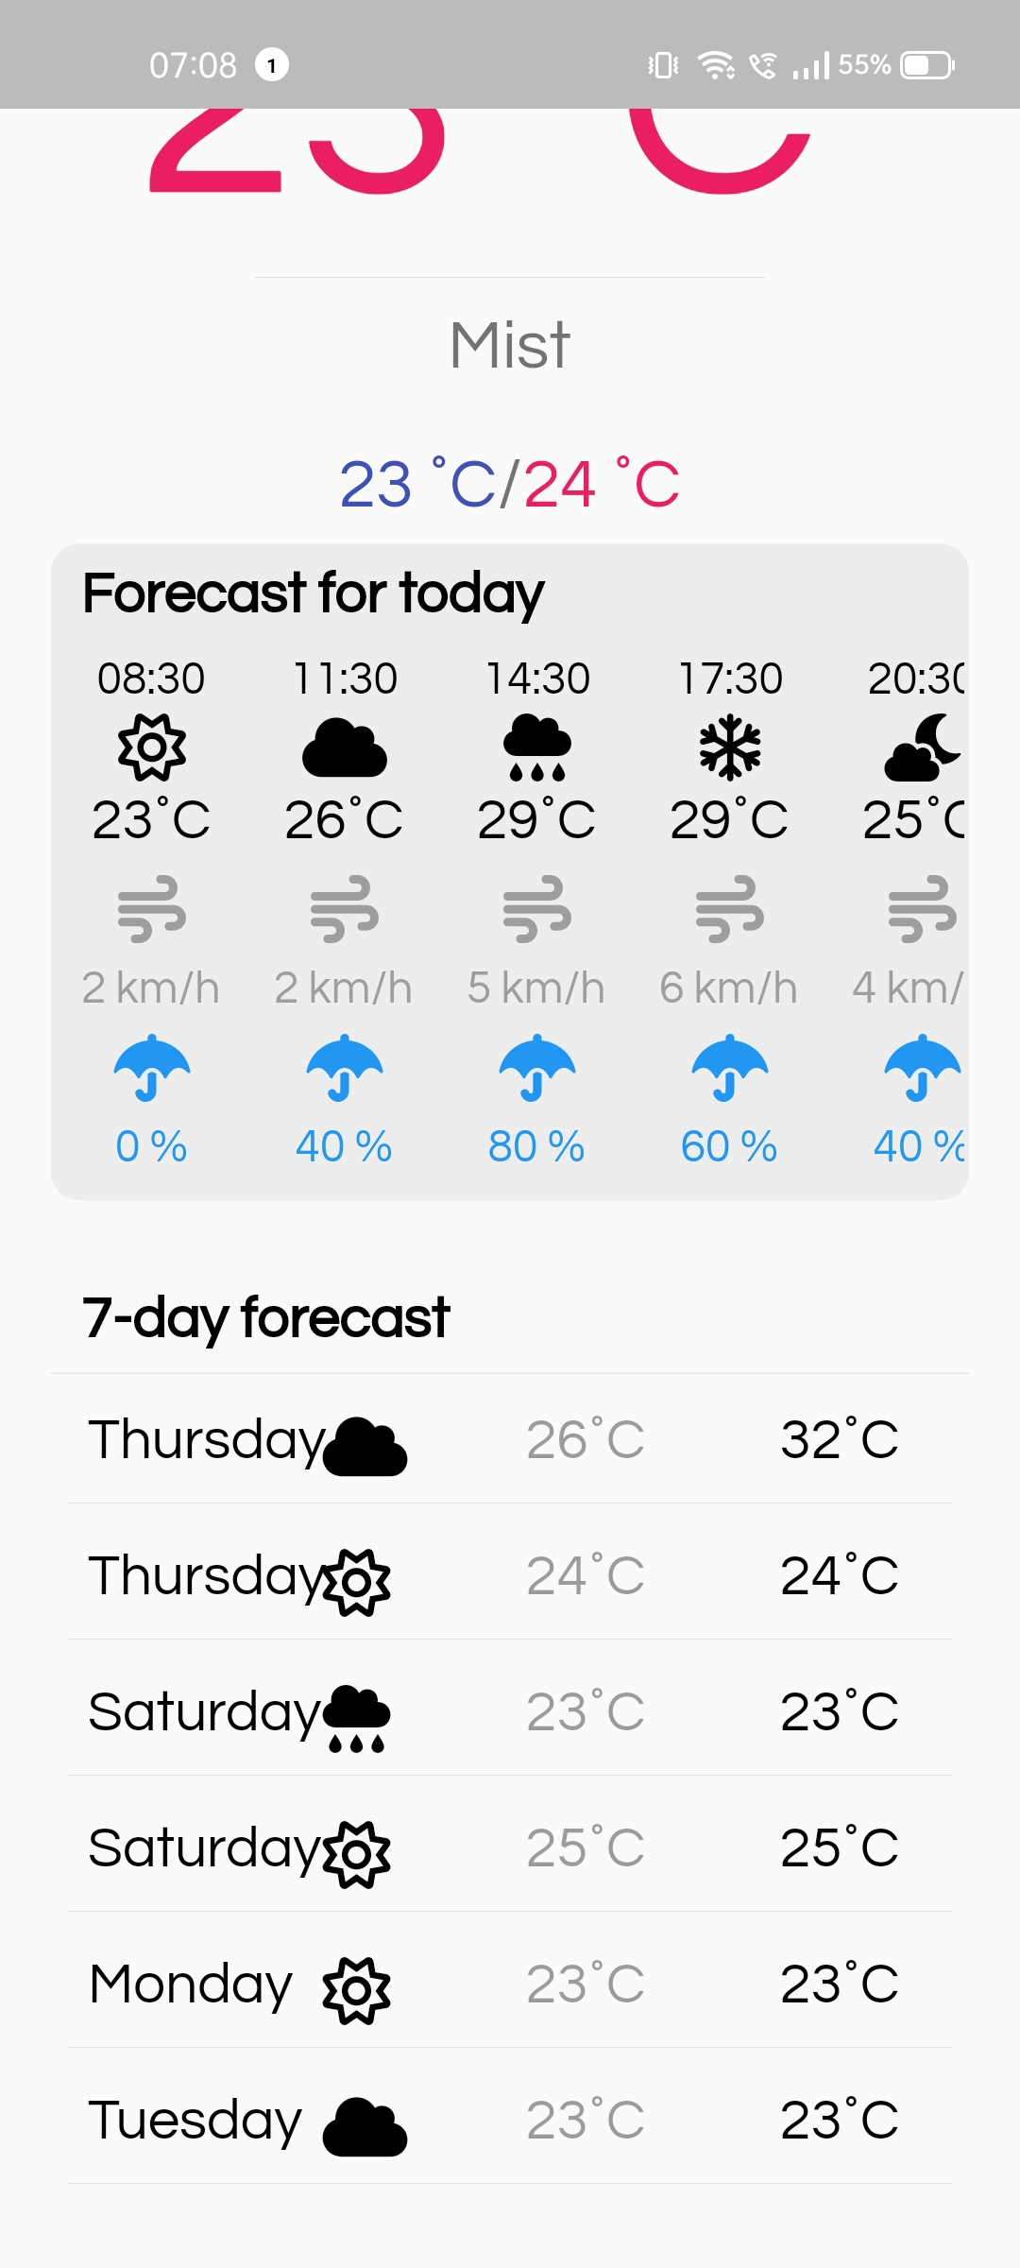
RESULT OF WEATHER PREDICTION
.

Slide 18
CROP RECOMMENDATION
The Crop Recommendation model is implemented with the crop recommendation model we created using the machine learning algorithms.
The model is converted into a Tflite model hence it could be integrated with the application’s user interface
The User Interface would ask the following details to suggest the crop
1. Nitrogen 2. Potassium
3. Phosphorous 4. Temperature
5. Humidity
The user interface would display the recommended crop for the user with the given details

Slide 19
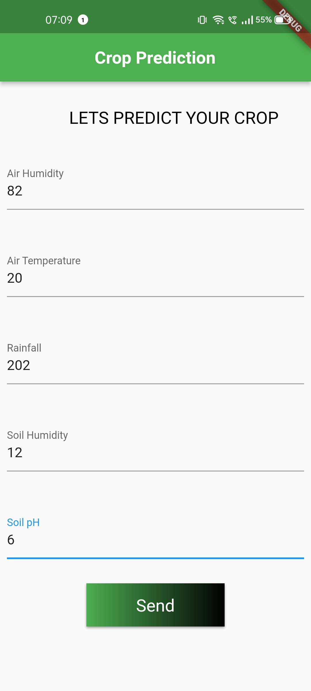
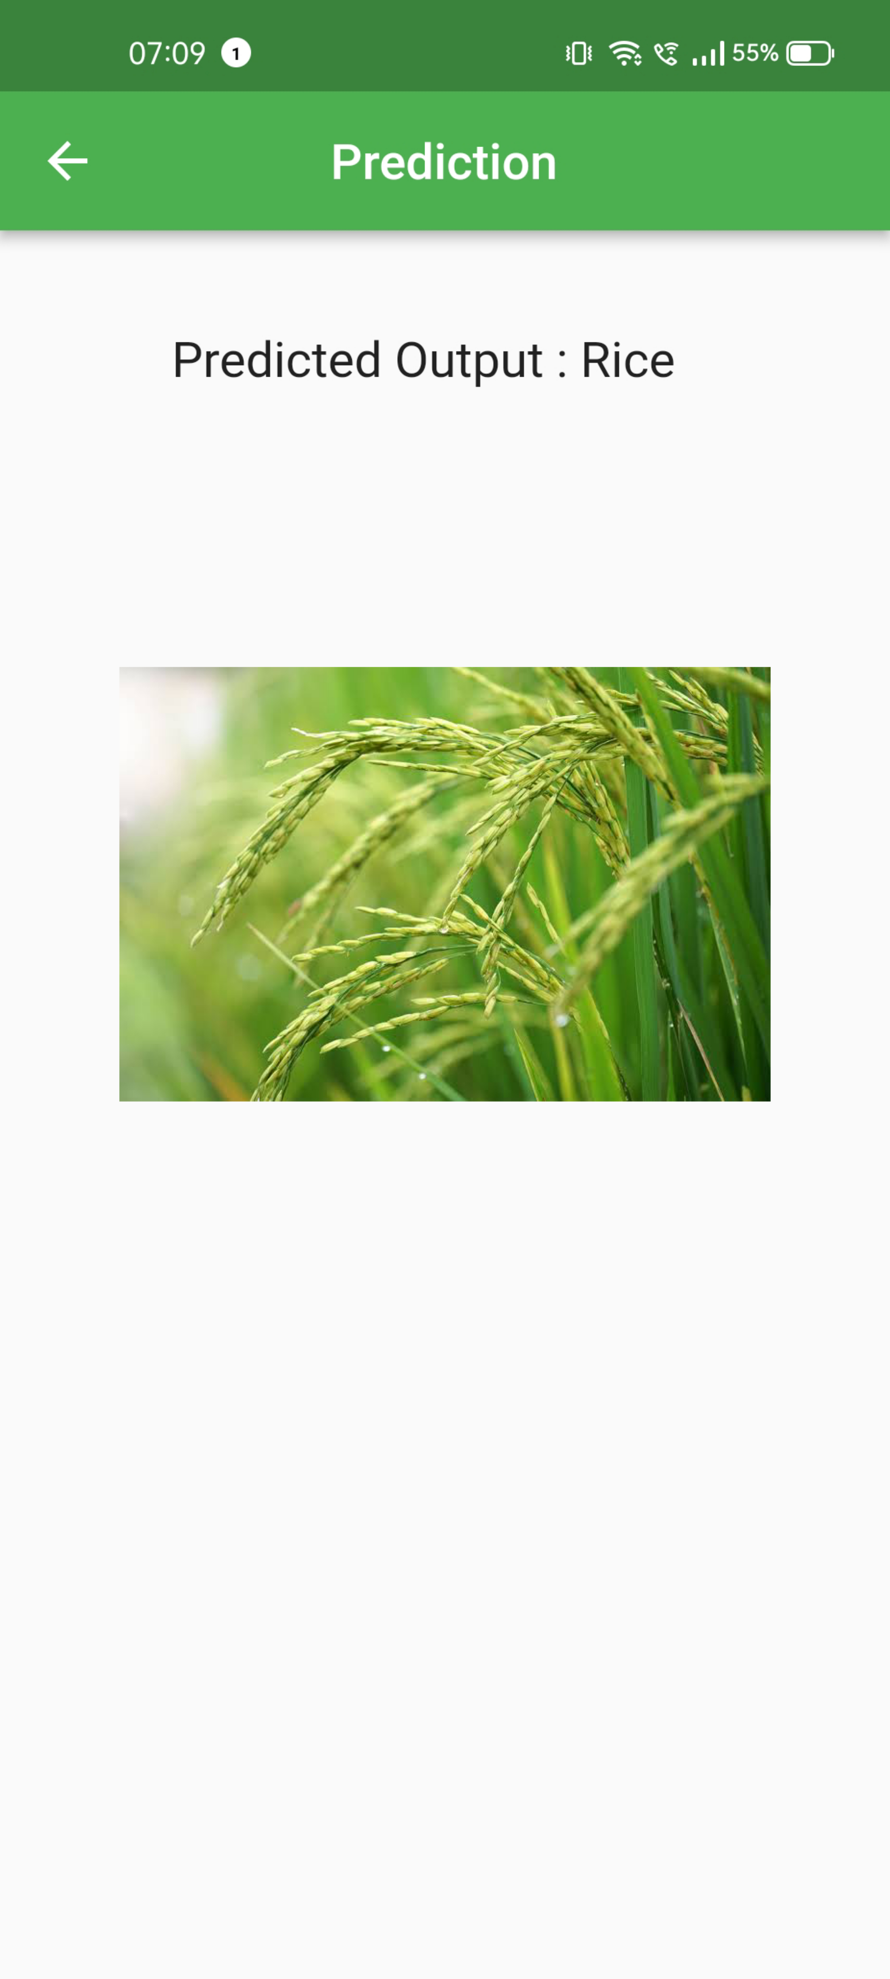
RESULT OF CROP RECOMMENDATION

Slide 20
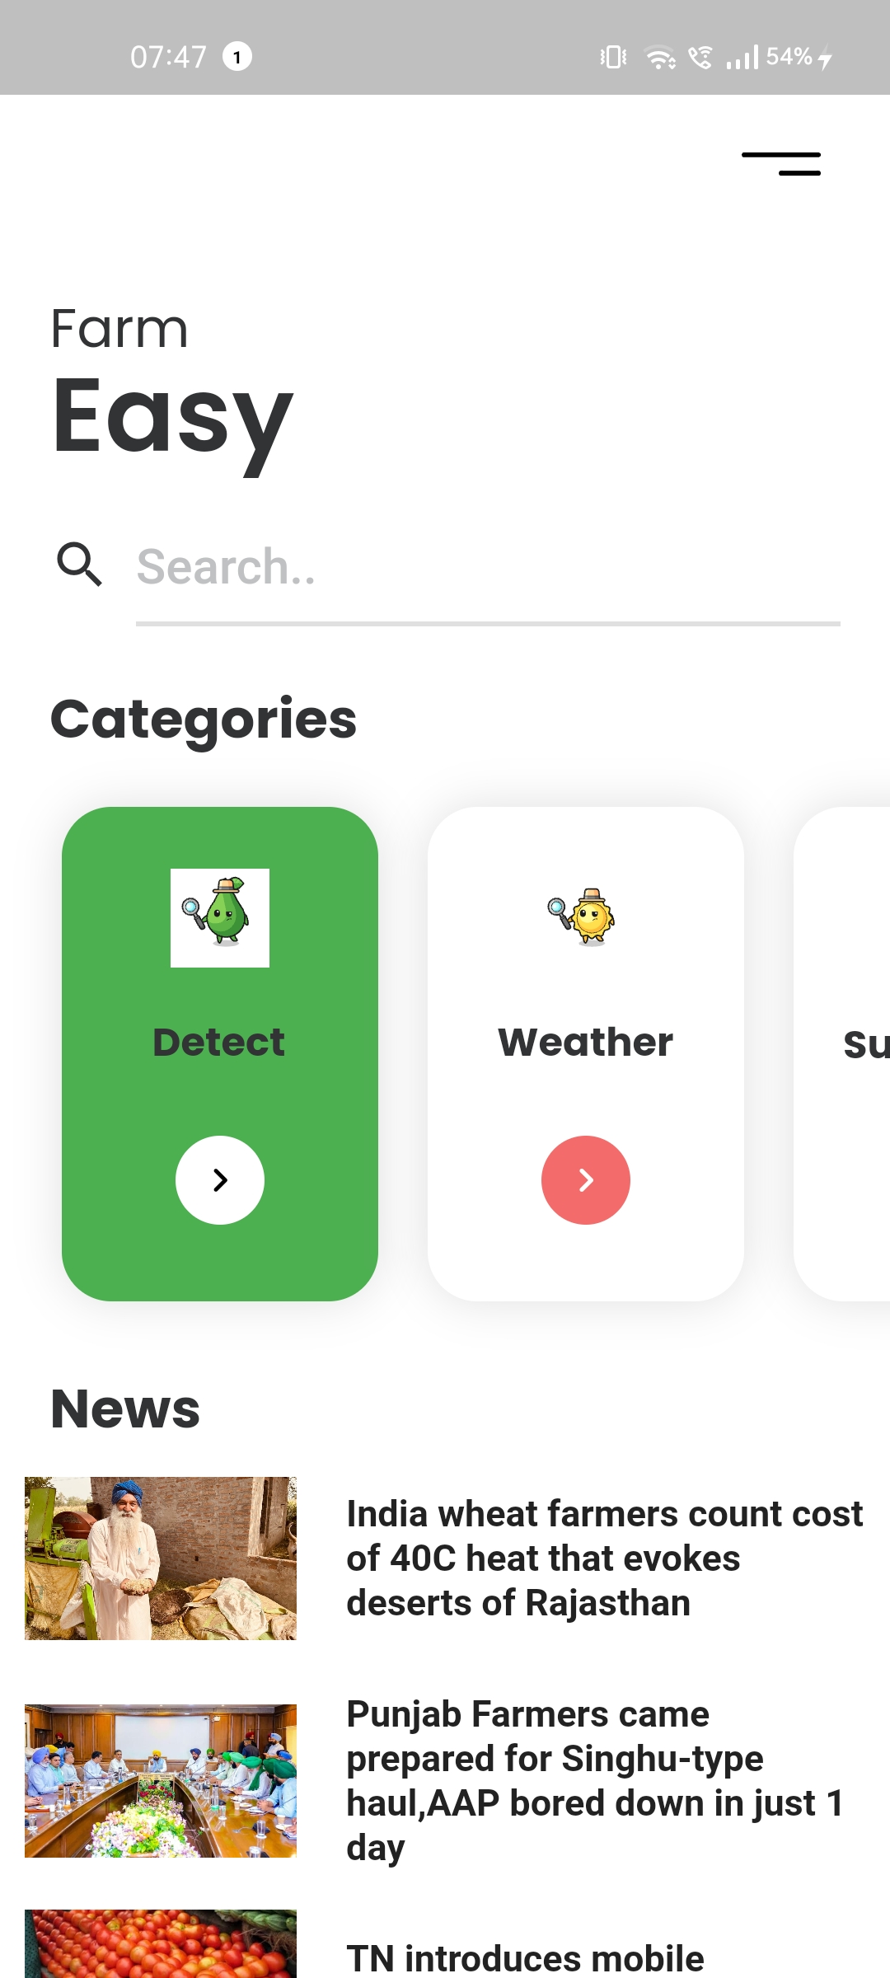
ALL MODULE

Slide 21
CONCLUSION
The rapid development in technology is a persistent process. This application provides various advantages to the farmers which integrated to work in increasing the global food productivity. It involves various machine learning and neural network algorithms that in co-ordination work for detection of pests affecting the plants and clustering classifier in turn helps to match the various factors for best outcome of the given condition. The weather recording has a huge impact for the good outcome from the crops and it is implemented via API calls from the open weather site.

Slide 22
CONCLUSION
ALGORITHMS | ACCURACY
Decision Tree | 98.40%
Logistic Regression | 94.54%
Random Forest | 99.54%
CNN | 89.25%

Slide 23
FUTURE SCOPE
Based upon the research, recommendations proposed for the further study are as follows:
The leaf disease detection model is trained for about 20 plants in the current project and many more plants dataset could be added and the model could be tuned well.
Can modify the weather module to make notification or alert on climate change.
The crop recommendation datasets could also be improved by adding additional datasets of plants.

Slide 24
REFERENCES
Alterra, INRA, 2005. New soil information for CGMS (Crop Growth Monitoring System) (SINFO). In: Alterra - INRA, Wageningen, pp. 219
Boogaard, H.L., Van Diepen, C.A., Roetter, R.P., Cabrera, J.M.C.A., Van Laar, H.H.,1998. WOFOST 7.1. User’s guide for WOFOST 7.1 crop growth simulation model and WOFOST control center 1.5. In: Technical Document 52. DLO Winand Staring Centre, Wageningen.
Fadzilah Siraj & Nureize Arbaiy, “ Integrated Pest Management System Using Fuzzy Expert System”, www. repo.uum.edu.my/1928/.
Fawad Baig, Naima Nawaz & Saif – Ur – Rahman (2005),”Expert System For Decision Making In Agriculture Sector”, Journal Of Agriculture and SocialScience, 1813-2235/2005/1-2-208-211.
GIS Solutions for Agriculture –Solutions for production, agribusiness and government, Esri Press (2007)

